Slide 1


Objectives
In this session, you will learn to:
  Use galleria plugin
  Implement geolocation
  Implement offline support

Slide 2
Using galleria Plugin
The galleria plugin:
  Is the jQuery plugin used for creating elegant and professional-looking image galleries.
  Has the ability to create thumbnails of the images to be displayed in the image gallery.
  Can be used by downloading the galleria.zip file from the Internet.

Slide 3
Demo: Creating an Image Gallery
Problem Statement:
  To enhance the browsing experience of the users, the management of ShowOnWheels website wants to display the image gallery of the movies. Therefore, they approach a Web developer to implement the required functionality on the website. After analyzing the requirement, the Web developer decides to create an image gallery by using the galleria plugin. Help the Web developer to create the image gallery.
  Prerequisite: To perform this activity, you need to use the ShowOnWheels file that you have created in Activity 7.1. In addition, you need the galleria-1.2.8.zip file and save it in the ShowOnWheels folder. Moreover, you need the following image files:
    movieimage1_bee.jpg
    movieimage1_bee1.jpg
    movieimage2_alvin.jpg
    movieimage2_alvin1.jpg
    movieimage3_amy.jpg
    movieimage4_bolt.jpg
    movieimage4_bolt1.jpg
    movieimage5_wolf.jpg
  Ask your faculty to provide you the same.

Slide 4
Demo: Creating an Image Gallery (Contd.)
Solution:
  To create an image gallery, you need to perform the following tasks:
    1. Copy the galleria plugin.
    2. Copy the jquery-1.8.3.js file.
    3. Copy the images to the contentFiles folder.
    4. Update the home.html file.
    5. Update the homestylesheet.css file.
    6. View the mainframe.html file.

Slide 5
Implementing Geolocation
Use the animation, HTML_08_Geolocation.swf, to understand the concept of geolocation.

Slide 6
Implementing the Geolocation API
The geolocation-enabled website:
  Can locate users’ current geographical location.
  Displays points of interest around that location.
  Guides the users from their current location to a target destination.

Slide 7
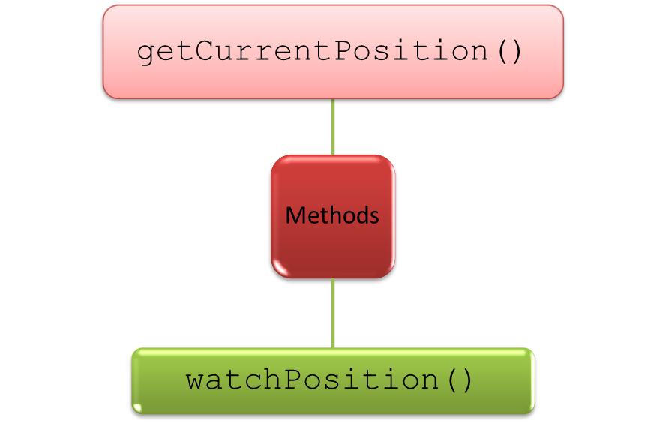
Implementing the Geolocation API (Contd.)
The Geolocation API:
  Allows a website to retrieve the current geographical location of a user.
  Enables you to create applications that guide users to reach a target location
  from their current location.
  Provides the following methods to determine the user’s location:

Slide 8
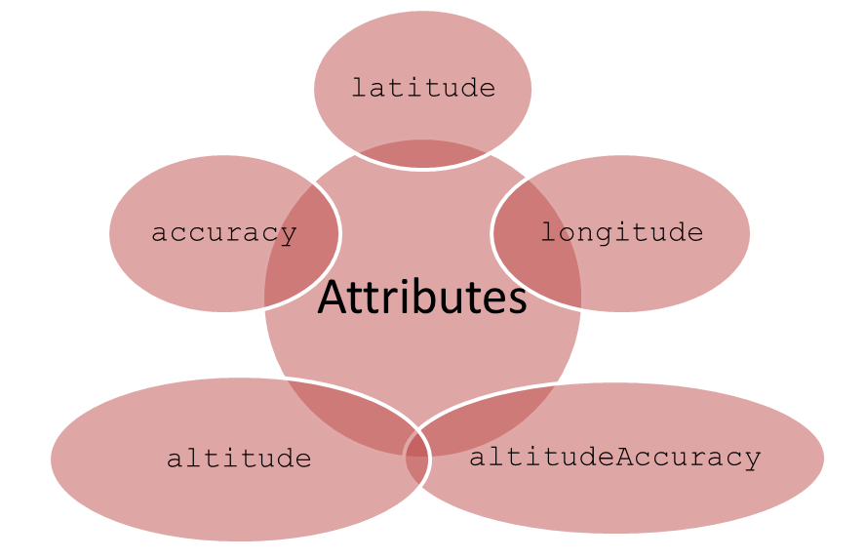
Implementing the Geolocation API (Contd.)
The getCurrentPosition() method:
  Is used to retrieve the current geographical location of a user.
  Has the following syntax:
    getCurrentPosition(CallbackFunction, ErrorHandler, Options);
  Invokes the CallbackFunction with the position object as argument.
  The position object returns the properties, coords and timestamp.
  The coords property returns the following attributes:

Slide 9
Implementing the Geolocation API (Contd.)
The watchPosition() method:
  Returns the current location of a user.
  Updates the location of the user while he is moving.
  Is mostly used in GPS devices.

Slide 10
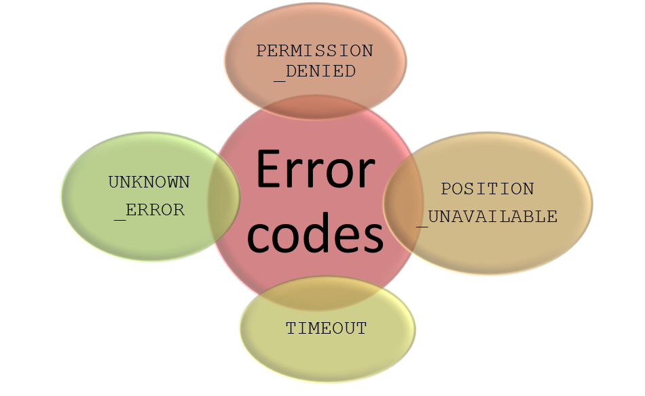
Handling Errors
  To handle errors in a geolocation-enabled website, you can use the getCurrentPosition() method.
  The second parameter of this method is an error handler function that has the following error codes:

Slide 11
Just a Minute
Which one of the following attributes of the coords property is used
to specify the altitude in meters above the sea level?
  coords.latitude
  coords.accuracy
  coords.altitude
  coords.altitudeAccuracy

Slide 12
Just a Minute (Contd.)
Solution:
  coords.altitude

Slide 13

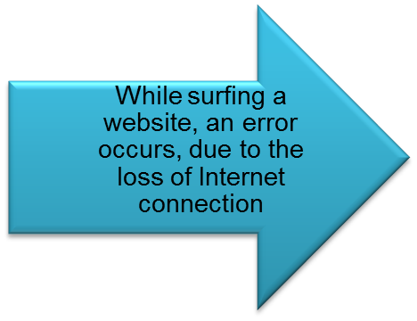
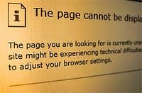


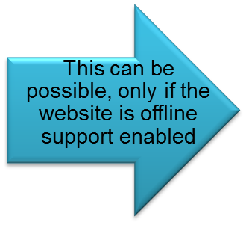

Implementing Offline Support
Scenario:

Slide 14
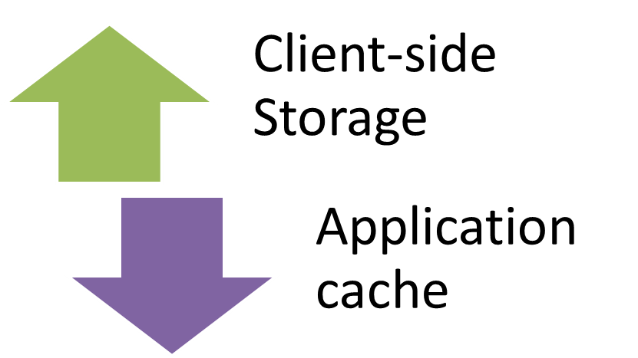
Implementing Offline Support (Contd.)
Offline support:
  Ensures that the website is available even when the user is not connected to the network.
  Reduces network load on the server.
  Can be implemented in the websites by using the following ways:

Slide 15
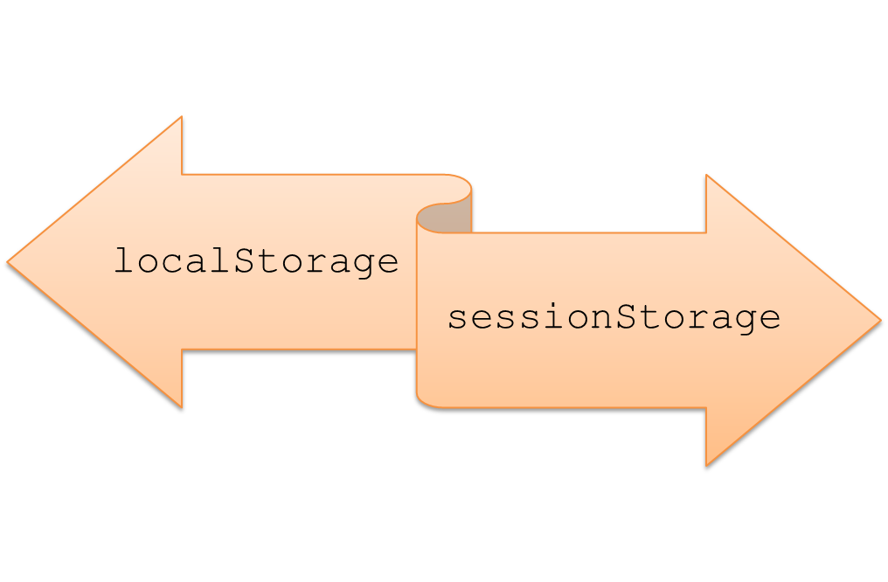
Implementing Client-side Storage
The client-side storage:
  Refers to the process of storing data locally within the user’s browser.
  Is implemented using the following objects:

Slide 16
Implementing Client-side Storage (Contd.)
The localStorage object:
  Allows you to store data within the browser without any expiration date.
  Stores the data as a key-value pair in the string format.
  For example:
    <SCRIPT>
    if(typeof(Storage)!=="undefined")
    {
    localStorage.name="John";
    document.getElementByID("str").innerHTML="Name: " +
    localStorage.name;
    }
    else
    {
    document.getElementByID("str").innerHTML="
    Your browser does not support local storage";
    }
    </SCRIPT>

Slide 17
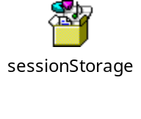
Implementing Client-side Storage (Contd.)
The sessionStorage object:
  Is used to store the data locally within the browser for only one session.
  Confines the stored data only to the browser for which it was created.
  The following embedded Notepad file shows the code to use the sessionStorage object:

Slide 18


Implementing Application Cache
Scenario:
The network connection is lost
While browsing a website
Click the Back button in the browser to view the previous page

Slide 19
Implementing Application Cache (Contd.)
Scenario (Contd.):
Not connected to the Internet
Not able to view the page
To view the page, you need to reconnect to the Internet
The browser did not cache the page properly

Slide 20
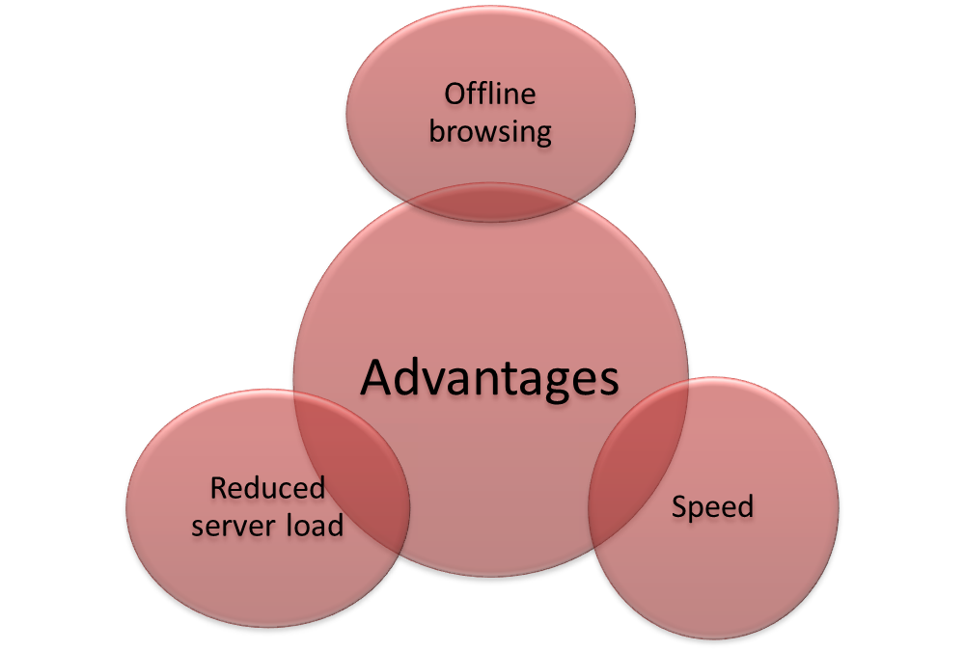
Implementing Application Cache (Contd.)
  The application cache:
  Caches a website so that you can view it even if you are not connected to the Internet.
  Provides the following advantages:

Slide 21
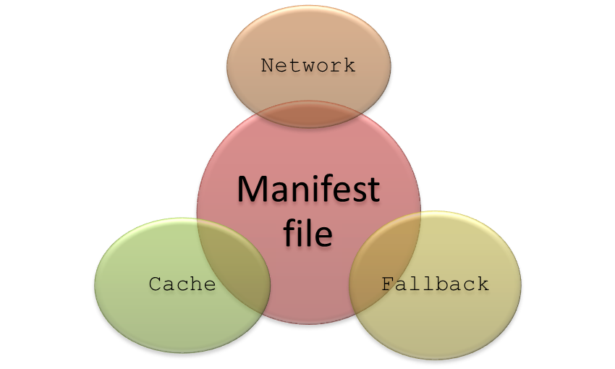
Implementing Application Cache (Contd.)
  To implement the application cache, you need to create a text file called manifest.
  This file contains a list of resources that needs to be cached for use when there is no network connectivity.
  The manifest file is divided into the following sections:
  Use the animation, HTML_08_OfflineSupport.swf, to understand the concept of offline storage.

Slide 22
Just a Minute
Which section of a manifest file lists the files that should never be cached?
  Cache
  Network
  Fallback
  FestCache

Slide 23
Just a Minute (Contd.)
Solution:
  Network

Slide 24
Demo: Implementing Offline Support
Problem Statement:
  You have been assigned a task to create the Web page, Register, in the ShowOnWheels website displaying two forms, Create an Account and Sign In. The Create an Account form contains the Name, Password, and Confirm Password fields. The Sign In form contains the Name and Password fields. You need to implement such functionality in the Create an Account form that upon filling the form, the details of the user should not be lost, if the browser is closed. In addition, when the user enters the name in the Name field in the Sign In form, the value in the Password field should be fetched automatically.
  How will you perform this task?
  Prerequisite: To perform this activity, you need to use the solution of ShowOnWheels that you have created in Activity 7.2. Ask your faculty to provide you the same.

Slide 25
Demo: Implementing Offline Support (Contd.)
Solution:
  To store the users’ details locally, you need to perform the following tasks:
    1. Create the login.html file.
    2. Update the nav.html file.
    3. View the login.html file.

Slide 26
Summary
In this session, you learned that:
  The galleria plugin is the jQuery plugin used for creating elegant and
  professional-looking image galleries.
  The Geolocation API allows a website to retrieve the current geographical location of a user.
  The Geolocation API provides the following methods to determine the users’ location:
    getCurrentPosition()
    watchPosition()
  To handle errors in a geolocation-enabled website, you can use the getCurrentPosition()method. The second parameter of this method is an error handler function.
  The offline support feature provides the following benefits:
    Ensures that the website is available even when the user is not connected to the network
    Reduces network load on the server
  The client-side storage refers to the process of storing data locally within the user’s browser.

Slide 27
Summary (Contd.)
  The client-side storage can be implemented by using the following objects:
    localStorage
    sessionStorage
  The localStorage object allows you to store data without any expiration date.
  The sessionStorage object is used to store the data for only one session. This implies that the data is deleted once the user closes the browser.
  To implement the application cache, you need to create a text file called manifest.

